Slide 1
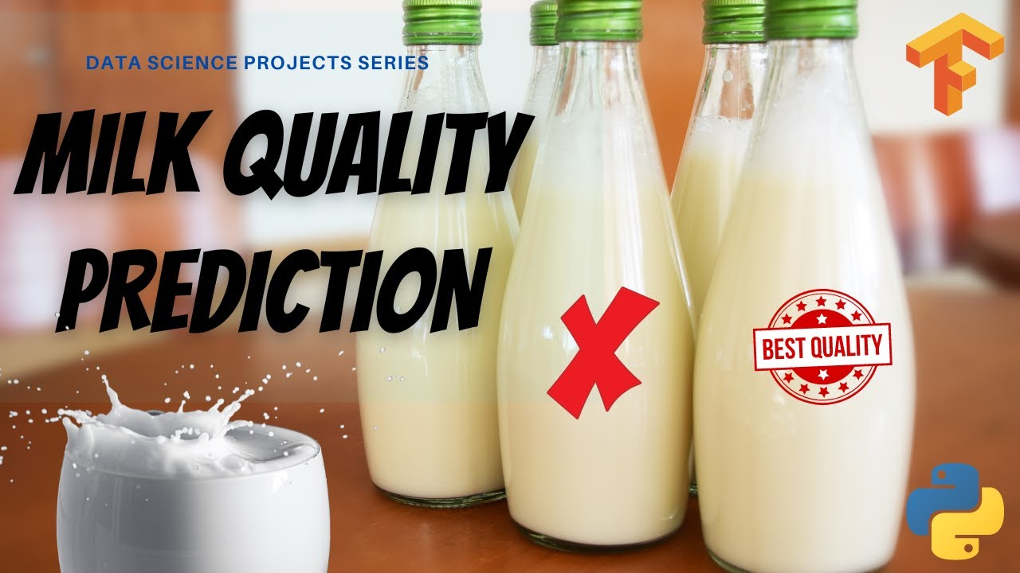
MILK QUALITY PREDICTION
Team Members:
2103A51134-M.Akshaya
2103A51336-R.Deepthi
2103A51027-N.Sathwika

Slide 2
Introduction
Milk quality prediction is the process of using data analysis and machine learning techniques to predict the quality of the milk. The quality of the milk can be affected by various factors such as the health and diet of the cows, the handling and storage conditions, and the processing techniques used.
Predicting milk quality can be essential for ensuring that the milk produced is safe for consumption and meets necessary standards. It can also help in identifying potential issues in the production process and taking appropriate corrective measures.

Slide 3
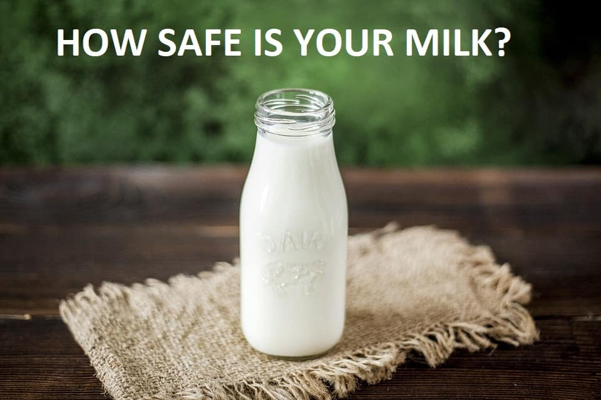
Machine learning algorithms can be trained on historical data to learn patterns an d relationships between various factors and milk quality. These algorithms can then be used to make predictions on new data, allowing for real time monitoring and early detection of any issues.
Milk quality predictions can be particularly important in the dairy industry, where large amounts of milk are produced and processed daily. By using data analysis and machine learning techniques to predict milk quality, dairy farmers and processors can ensure that their products are safe, high-quality, and meet the necessary standards.

Slide 4
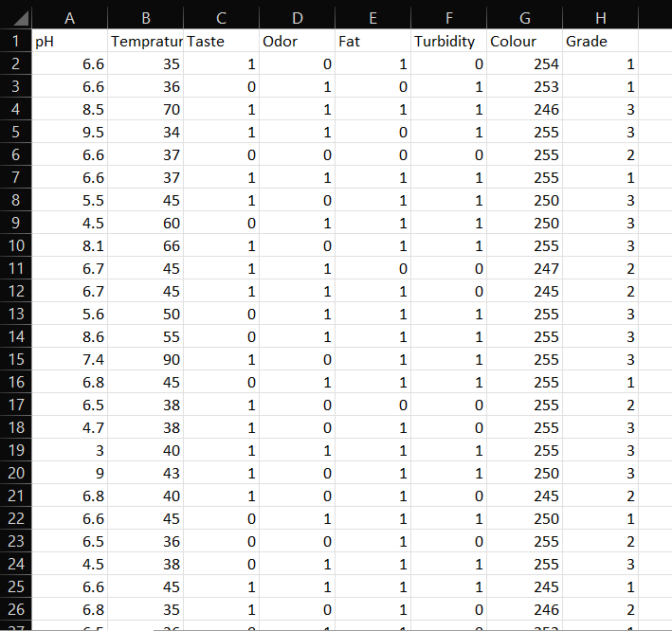
Dataset
This dataset contains 1059 rows and 8 columns.
By using seven attributes of the milk samples, low, medium, high quality classification of milk carried out.
Grade depends on these seven factors.
In the Grade attribute, numbers 1, 2, 3 represent the high, medium, low quality respectively.

Slide 5
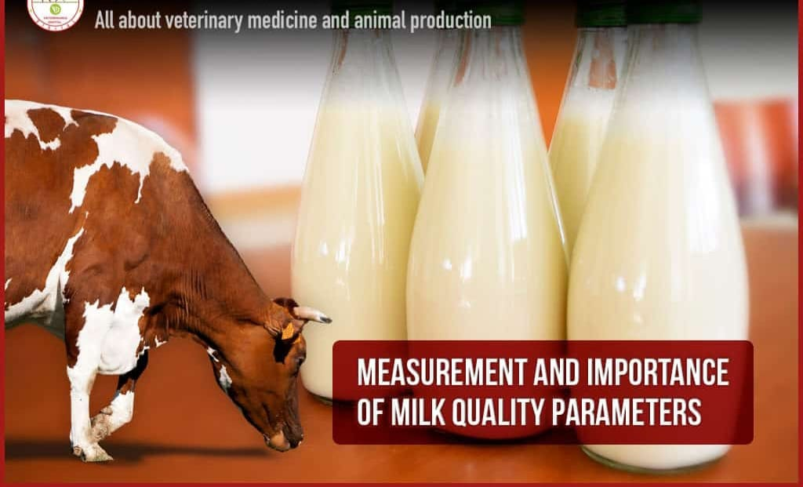
Independent Values
pH
Temperature
Taste
Odour
Fat
Turbidity
Colour

Slide 6
Target variable
We had taken grade as target variable from the dataset. Here grade of milk is based on various features or inputs.
The grade of milk refers to its quality and can be determined based on several factors, including the composition of milk, the presence of any contaminants or impurities and the milk’s sensory properties, such as taste and odour.
Depending on the seven factors of the milk, we get an output grade as 1 for high quality, 2 for medium quality and 3 for low quality.

Slide 7
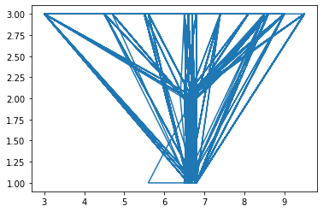
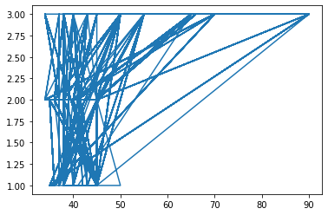
Graphs
Following are the graphs plotted by taking grade on y-axis and other attributes on x-axis.
pH
Temperature

Slide 8
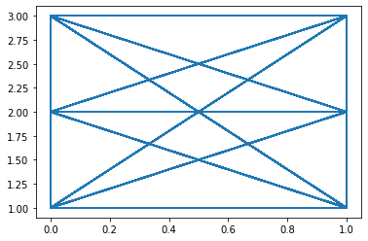
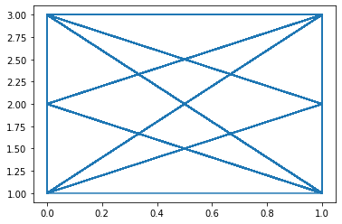
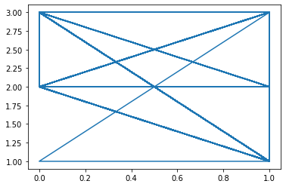
Taste
Odour
Fat

Slide 9
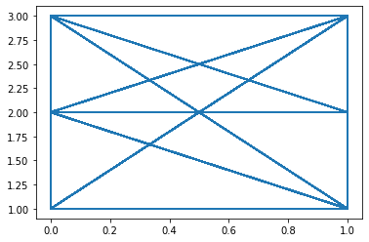
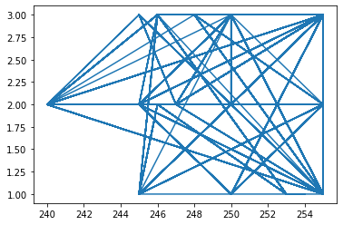
Turbidity
Colour

Slide 10
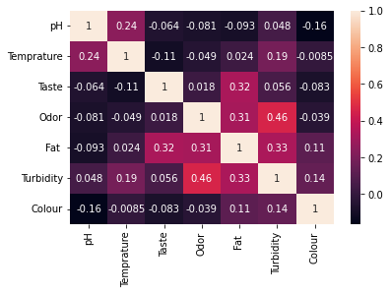
Correlation Matrix
A correlation matrix is a table that displays the correlation coefficients between multiple variables.
Correlation coefficients measure the strength and direction of the linear relationship between two variables with values ranging from -1 to 1.
A correlation coefficient 1 indicates a perfect positive correlation, coefficient 0 indicates no correlation and coefficient -1 indicates a perfect negative correlation.
By analysing the correlation matrix, researchers and analysts can identify which factors have the strongest correlation with the milk quality and use that information to develop models or interventions to improve milk quality.

Slide 11
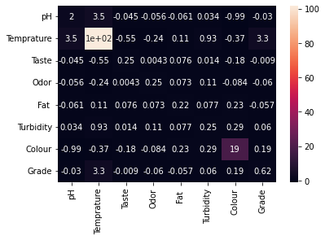
Covariance Matrix
A covariance matrix is a square matrix that contains covariances between pairs of datasets.
The diagonal elements of a covariance matrix represents the variance of each variable, while the off-diagonal elements represents the covariance between pairs of variables.
A positive covariance between two variables indicates that they tend to increase or decrease together, while a negative covariance indicates that one tends to increase while the decreases.

Slide 12
Methodology
Logistic Regression
Logistic Regression is a machine learning algorithm which comes under supervised learning. Logistic Regression is a classification problem used when the target variables are in categorical in nature. Logistic Regression uses a Sigmoid function also known as logistic function.
from sklearn.linear_model import LogisticRegression

Slide 13
Decision Tree
Decision tree is a non-parametric supervised machine learning used for both classification and regression. Decision tree uses the tree representation to solve the problem. The primary challenge in the decision tree implementation is to identify the attributes. There are two attribute selection methods they are entropy and information gini.
from sklearn.tree import DecisionTreeClassifier
K-Nearest Neighbour
K-NN algorithm stores all the available data and classifies a new data point based on the similarity. This means when new data appears then it can be easily classified into well suite category by using K-NN algorithm.
from sklearn.neighbors import KNeighborsClassifier

Slide 14
Gaussian Naïve Bayes
Gaussian Naïve Bayes is a probabilistic algorithm used for classification tasks. It is based on bayes theorem. During prediction, the algorithm calculates the probability of each class for a given set of features using bayes theorem and selects the class with the highest probability.
from sklearn.naive_bayes import GaussianNB
Support Vector Machine
SVM is a supervised learning algorithm used for both regression and classification. We perform classification by finding the hyperplane that differentiates the two classes very well. The goal is to choose a hyperplane with the greatest possible margin.
from sklearn.svm import SVC

Slide 15
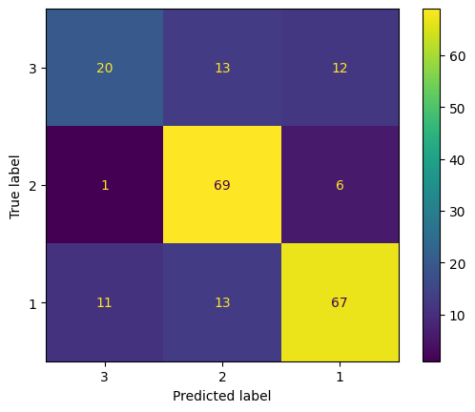
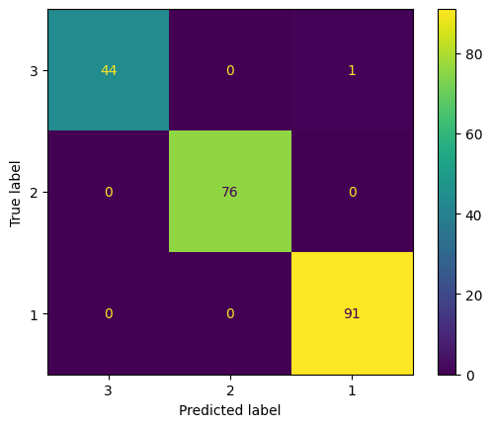
Results
Logistic Regression
Decision Tree
Accuracy: 0.7358490566037735
Accuracy: 0.9952830188679245

Slide 16

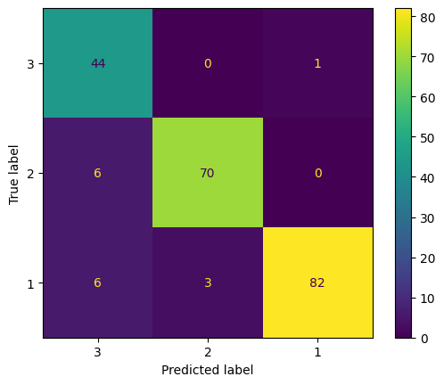
K-Nearest Neighbour
Gaussian Naïve Bayes
Accuracy: 0.9858490566037735
Accuracy: 0.9245283018867925

Slide 17
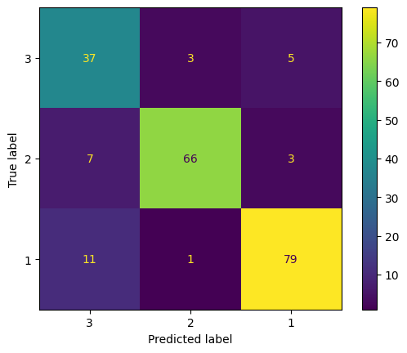
Support Vector Machine
Accuracy: 0.8584905660377359

Slide 18
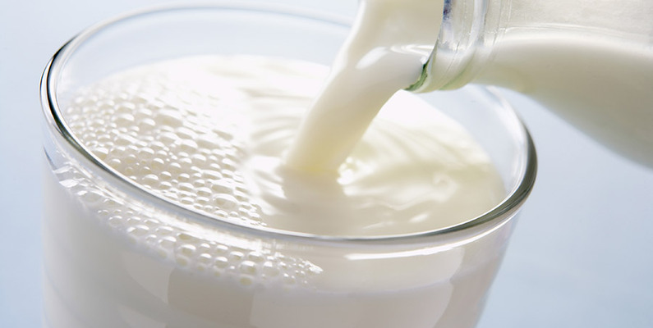
Conclusion
In conclusion, milk quality prediction is a vital process in the dairy industry that can help ensure safety and quality of milk products. Machine learning algorithms can be trained on historical data to identify patterns and relationships between various factors and milk quality. These algorithms can then be used to predict milk quality in real time, allowing for early detection of any potential issues. We can conclude that Decision tree is the best model for our dataset as it got highest accuracy among all other models. Even according to the confusion matrix, Decision tree is the best suitable model.

Slide 19
THANK YOU

